Slide 1
SWE4005- Storage Technology and Management
Storage Virtualization

Slide 2
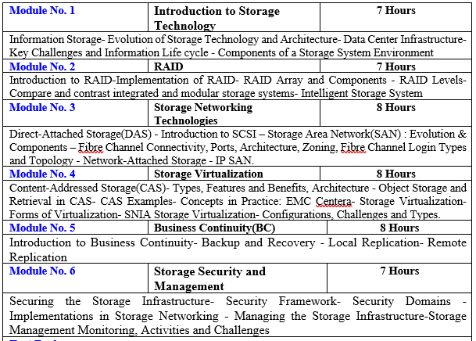
Modules

Slide 3
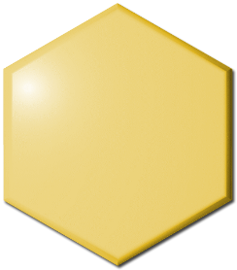
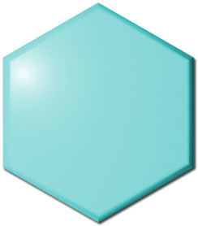
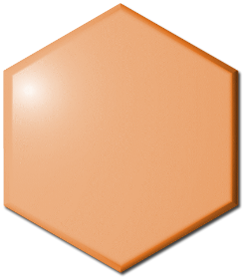
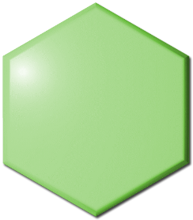
Virtualization Comes in Many Forms
Virtual Memory
Each application sees its own logical
memory, independent of physical memory
Virtual Networks
Each application sees its own logical
network, independent of physical network
Virtual Servers
Each application sees its own logical
server, independent of physical servers
Virtual Storage
Each application sees its own logical
storage, independent of physical storage
3
Notes:
As previously mentioned, virtualization has been in use for many years. Here are some examples of virtualization:
Virtual memory
Virtual networks
Virtual servers
Virtual storage

Slide 4
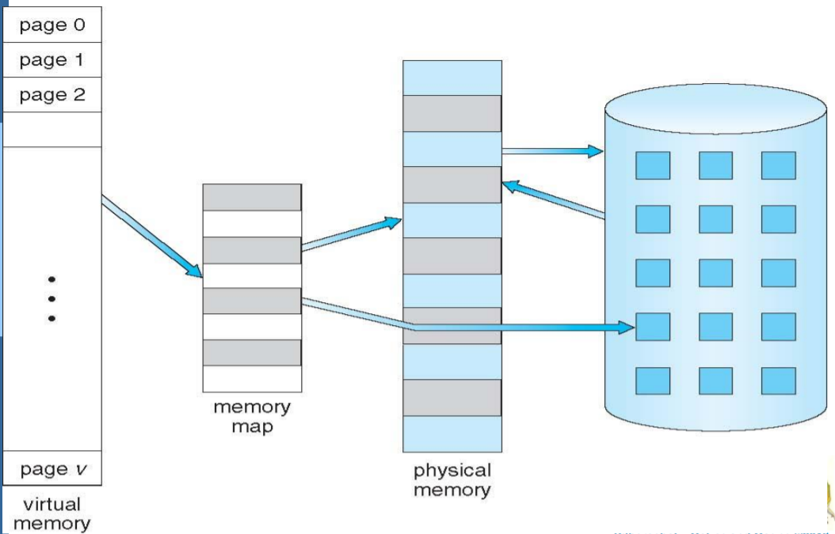

Slide 5
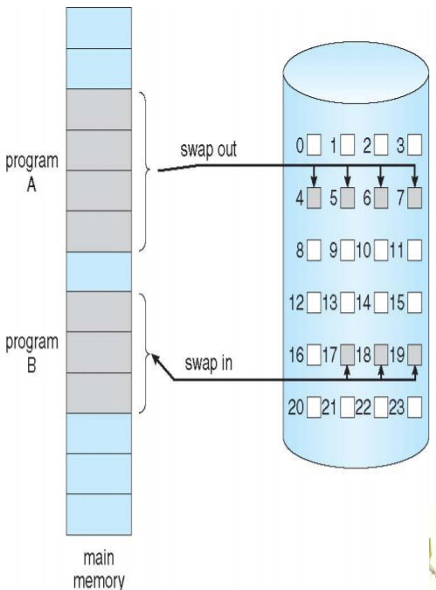

Slide 6
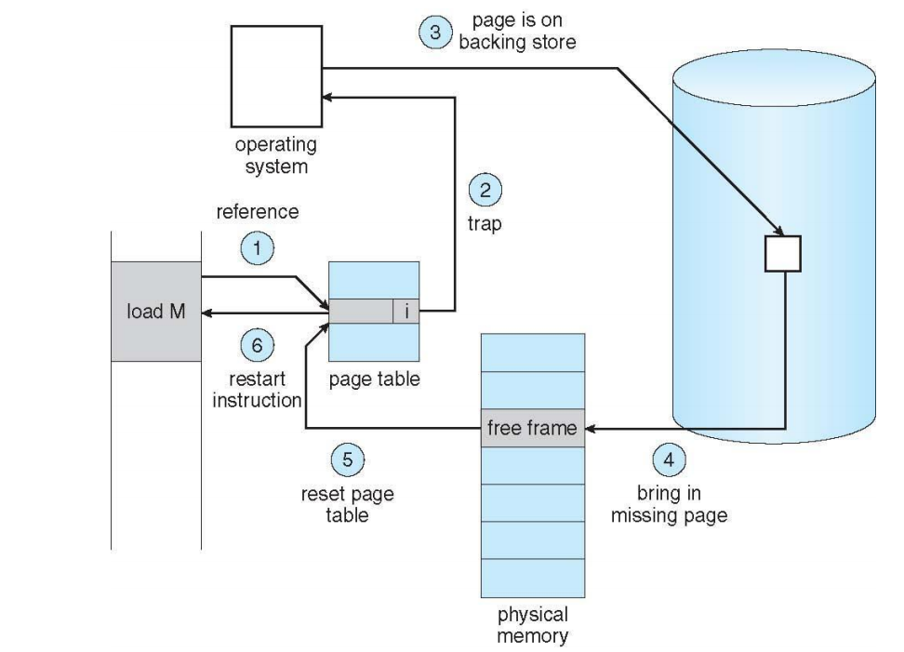

Slide 7
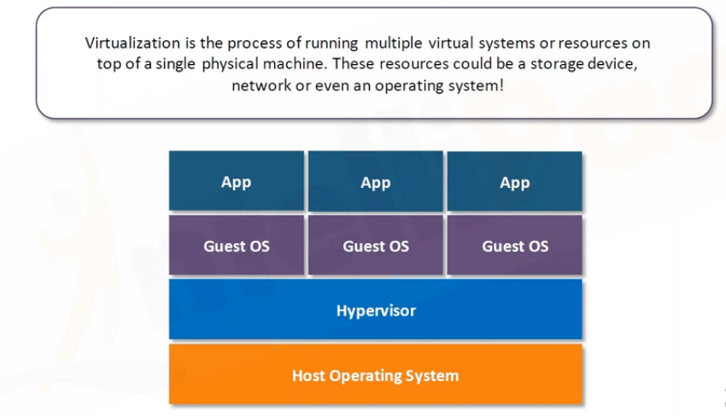
Virtualization

Slide 8
VLAN
A VLAN is logical partition of layer 2 network
Multiple partitions can be created allowing for multiple VLANS to co-exist
Each VLAN is a broadcast domain, usually with its own ip network
VLANs are mutually isolated and packets can only pass between them via router
The partitioning of the layer 2 network takes place inside a layer 2 device , usually via switch.
The hosts are grouped within a VLAN are unaware of the VLAN’s existence.

Slide 9
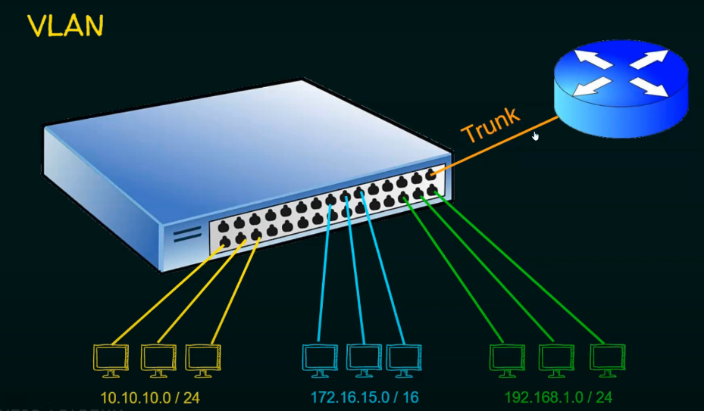

Slide 10
Benefits of VLAN
Security
Cost reduction
Better performance
Shrinks Broadcast domain

Slide 11
SNIA Storage Virtualization Taxonomy
Storage
Virtualization
What is created
Block
Disk
Tape, Tape Drive,
File System,
Other Device
Virtualization
Virtualization
Tape Library
File/record
Virtualization
Virtualization
Virtualization
Where it is done
Host Based
Network
Storage Device/Storage
Virtualization
Based Virtualization
Subsystem Virtualization
How it is implemented
In-band
Out-of-band
Virtualization
Virtualization
Notes:
The SNIA (Storage Networking Industry Association) storage virtualization taxonomy provides a systematic classification of storage virtualization, with three levels defining what, where, and how storage can be virtualized. The first level of the storage virtualization taxonomy addresses “what” is created. It specifies the types of virtualization: block virtualization, file virtualization, disk virtualization, tape virtualization, or any other device virtualization. Block-level and file-level virtualization are the core focus areas covered later in this module.

Slide 12
Storage Virtualization
Storage virtualization
It is the process of masking the underlying complexity of physical storage resources and presenting the logical view of these resources to compute systems.
Logical to physical storage mapping is performed by virtualization layer
Virtualization layer abstracts the identity of physical storage devices
Creates a storage pool from multiple, heterogeneous storage arrays
Virtual volumes are created from the storage pools and are assigned to the compute system

Slide 13
Benefits of Storage Virtualization
Adds or removes storage without any downtime
Increases storage utilization thereby reducing TCO
Provides non-disruptive data migration between storage devices
Supports heterogeneous, multi-vendor storage platforms
Simplifies storage management

Slide 14

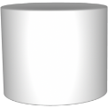
Memory Virtualization
Virtual Memory
Each application sees its own logical
memory, independent of physical memory
Physical memory
App
App
App
Benefits of Virtual Memory
Remove physical-memory limits
Run multiple applications at once
Swap space
14
Notes:
Virtual memory makes an application appear as if it has its own contiguous logical memory independent of the existing physical memory resources.
Since the beginning of the computer industry, memory has been and continues to be an expensive component of a host. It determines both the size and the number of applications that can run on a host.
With technological advancements, memory technology has changed and the cost of memory has decreased. Virtual memory managers (VMMs) have evolved, enabling multiple applications to be hosted and processed simultaneously.
In a virtual memory implementation, a memory address space is divided into contiguous blocks of fixed-size pages. A process known as paging saves inactive memory pages onto the disk and brings them back to physical memory when required. This enables efficient use of available physical memory among different processes. The space used by VMMs on the disk is known as a swap file. A swap file (also known as page file or swap space) is a portion of the hard disk that functions like physical memory (RAM) to the operating system. The operating system typically moves the least used data into the swap file so that RAM will be available for processes that are more active. Because the space allocated to the swap file is on the hard disk (which is slower than the physical memory), access to this file is slower.

Slide 15
In a virtual memory implementation, a memory address space is divided into contiguous blocks of fixed-size pages.
A process known as paging saves inactive memory pages onto the disk and brings them back to physical memory when required.
This enables efficient use of available physical memory among different processes.
The space used by VMMs on the disk is known as a swap file.
A swap file (also known as page file or swap space) is a portion of the hard disk that functions like physical memory (RAM) to the operating system.
The operating system typically moves the least used data into the swap file so that RAM will be available for processes that are more active. Because the space allocated to the swap file is on the hard disk (which is slower than the physical memory), access to this file is slower.

Slide 16
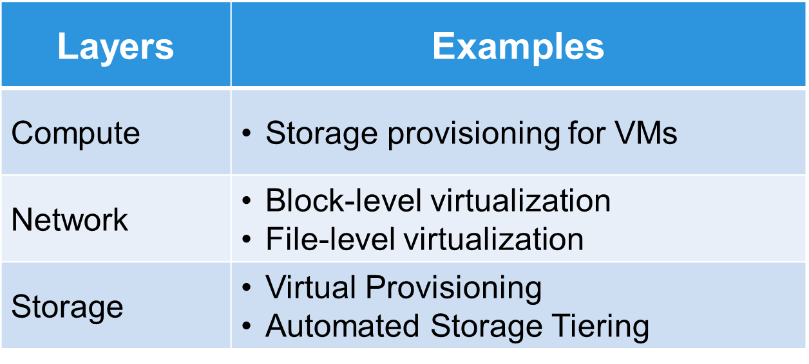
Storage Virtualization at Different Layers

Slide 17
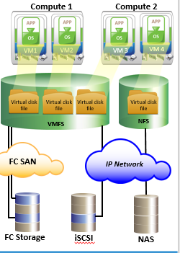
Storage for Virtual Machines
VMs are stored as set of files on storage space available to hypervisor
‘Virtual disk file’ represents a virtual disk used by a VM to store its data
Size of virtual disk file represents storage space allocated to virtual disk
VMs remain unaware of
Total space available to the hypervisor
Underlying storage technologies

Slide 18
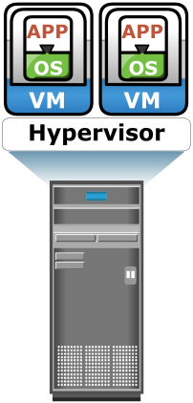
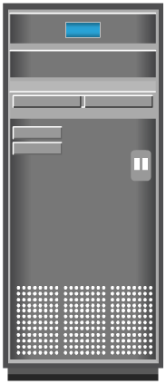
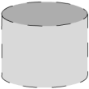


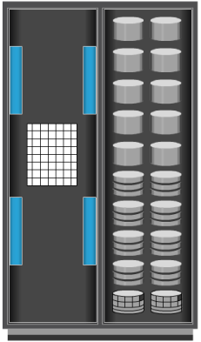
Block-level Storage Virtualization
Servers
Provides a virtualization layer in SAN
Abstracts block storage devices and creates a storage pool by aggregating LUNs
Virtual volumes are created from storage pool and assigned to hosts
Virtualization layer maps virtual volumes to LUNs
Benefits
Online volume expansion
Nondisruptive migration
Server
FC SAN
Virtual Volume
Virtualization
Appliance
LUN
Storage Pool
LUN
LUN
LUN
Storage Array
Storage Array

Slide 19

Use Case: Block-level Storage Virtualization across Data Centers
Data Center 1
Data Center 2
Servers
Servers
Server
Server
Virtual
Volumes
Virtual
Volumes
Virtualization Appliance
FC or IP
FC SAN
FC SAN
Virtualization Layer
Storage Arrays
Storage Arrays

Slide 20
Virtual SAN (VSAN)/Virtual Fabric
VSAN 10
VSAN 20
VSAN
Servers
Servers
It is a logical fabric on an FC SAN, enabling communication among a group of nodes, regardless of their physical location in the fabric.
Server
Server
Each VSAN has its own fabric services (name server, zoning), configuration, and set of FC addresses
VSANs improve SAN security, scalability, availability, and manageability
FC SAN
Storage Array
Storage Array

Slide 21
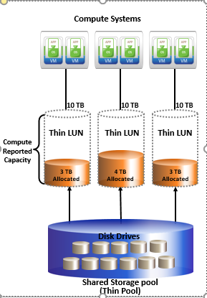
Virtual Provisioning (Thin Provisioning)
Virtual Provisioning (Thin Provisioning)
It is the ability to present a LUN to a compute system with more capacity than what is physically allocated to the LUN.
Capacity-on-demand from a shared storage pool, called Thin pool
Physical storage is allocated only when the compute requires it
Provisioning decisions not bound by currently available storage
May be implemented at
Storage layer
Compute layer – virtual Provisioning for virtual disk

Slide 22
Storage Virtualization Challenges
Scalability
Ensure storage devices perform appropriate requirements
Functionality
Virtualized environment must provide same or better functionality
Must continue to leverage existing functionality on arrays
Manageability
Virtualization device breaks end-to-end view of storage infrastructure
Must integrate existing management tools
Support
Interoperability in multivendor environment
Notes:
Storage networking and feature-rich intelligent storage arrays have addressed and provided specific solutions to business problems. As an enabler, virtualization should add value to the existing solution, but introducing virtualization into an environment adds new challenges. The storage virtualization solution must be capable of addressing issues such as scalability, functionality, manageability, and support.
Scalability:
Consider the scalability of an environment with no virtualization. This environment may have several storage arrays that provide storage independently of each other. Each array is managed independently and meets application requirements in terms of IOPS and capacity. After virtualization, a storage array can no longer be viewed as an individual entity. The environment as a whole must now be analyzed. As a result, the infrastructure that is implemented both at a physical level and from a virtualization perspective must be able to adequately handle the workload.
Functionality:
Storage array provides a wide range of advanced functionality necessary for meeting an application’s service levels. This includes local replication, extended-distance remote replication. In a virtualized environment, the virtual device must provide the same or better functionality than what is currently available on the storage array, and it must continue to leverage existing functionality on the arrays.
Manageability:
Introducing a virtualization device breaks the end-to-end view into three distinct domains: the server to the virtualization device, the virtualization device to the physical storage, and the virtualization device itself. The virtualized storage environment must be capable of meeting these challenges and must integrate with existing management tools to enable management of an end- to-end virtualized environment.
Support:
Virtualization is not a stand-alone technology but something that has to work within an existing environment which is complex and often requires multiple management tools that introduces interoperability issues. Without a virtualization solution, many companies try to consolidate products from a single vendor to ease these challenges. Introducing a virtualization solution reduces the need to standardize on a single vendor. However, supportability issues in a virtualized heterogeneous environment introduce challenges in coordination and compatibility of products and solutions from different manufacturers and vendors.

